Slide 1
Power Point Slide Show GUIDELINES
See teacher example
Delete this slide after you complete your slide show
Choose a pleasant background
(same color for all slides) located in the DESIGN tab / Format Background
Choose a clear and easy to read font (no cursive) you can adjust size to fix the text contained in each slide; between 18 points or larger; exceptions will be noted at the bottom of each slide.
Read teacher notes and HINTS posted at the bottom of each slide. You should delete this notes after you are complete your slide show.
Label all slides with its corresponding component at the top and at the bottom or slide include your project title, name, teacher name and grade
You may insert video, audio, free clipart, transitions, and animations.
Don’t use more that 30 slides if more are required please consult with me.
Refer to the rubric to ensure you meet the criteria to earn the most points possible.
Notes:
Delete this slide after you thoroughly check your work and you are satisfied that it has been completed to the best of your abilities.
HINT: It’s always a good idea to have an adult help you check your work using the rubric.
Have fun! ☺ Mrs. Rivera

Slide 2
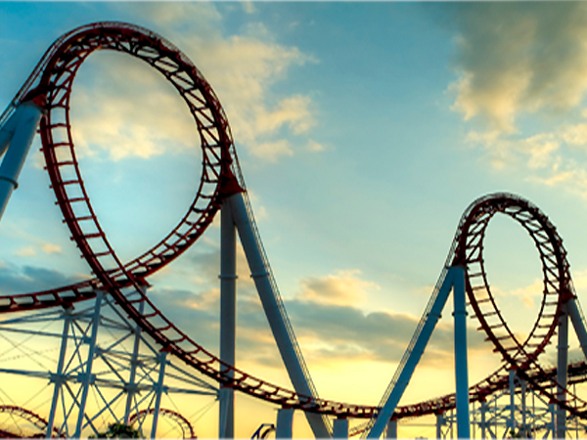
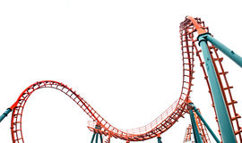
Roller Coaster Marbles:
How Much Height to
Loop the Loop?
Miranda Smith
Mrs. Rivera
March 7, 2016
Notes:
Project Title Slide – OPTION 1
HINT: For the title slide you may insert an image on the background. You may choose the font size for the title ☺
Don’t forget to include your name, teacher name and due date for your project.

Slide 3
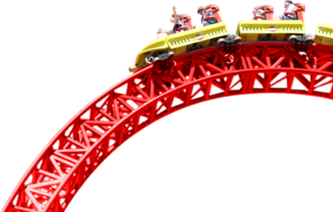
Roller Coaster Marbles:
How Much Height to
Loop the Loop?
Miranda Smith
Mrs. Rivera
March 7, 2016
Notes:
Project Title Slide – OPTION 2
HINT: For the title slide you may insert an image over the background. You may choose the font size for the title ☺
Don’t forget to include your name, teacher name and due date for your project.

Slide 4
Testable Question
How does changing the height of the track (20, 40, 60, 80, and 100 cm) affect whether the marble can “loop the loop”?
Notes:
Testable Question Slide
HINT: Center the text and use font size between 16 – 24 and line spacing between 1.5 – 2.5 ☺
You may insert an image over the background.
Don’t forget to include project title, your name, teacher name and grade; at the bottom or side of the slide.

Slide 5
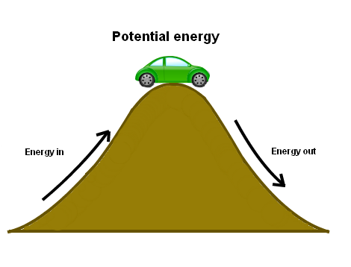
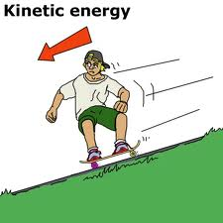
Research – Vocabulary
Potential energy (stored energy) – is a result of gravity pulling downwards.
Kinetic energy (energy of motion) – is the energy that an object possesses due to its motion.
Conservation of energy (basic law of physics) – energy can neither be created nor destroyed; rather, it transforms from one form to another.
Gravity – the force that attracts a body toward the center of the earth
Velocity – the speed of something in a given direction
Notes:
Research Slide(s) Vocabulary
You may need more than one slide depending on the number of terms your project has.
HINT: Justify the text to the left and use size between 16 - 24 and line spacing between 1.5 – 2.5 ☺
You may insert images that show examples of the terms.
Don’t forget to include project title, your name, teacher name and grade; at the bottom or side of the slide.

Slide 6
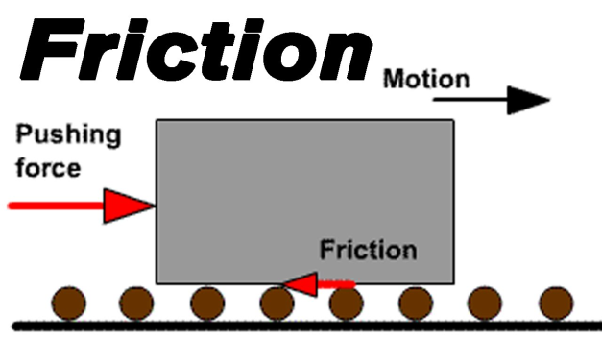
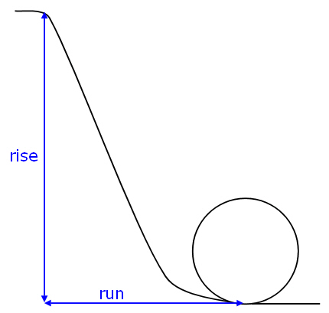
Research – Vocabulary
Friction – the resistance that one surface or object encounters when moving over another.
Slope (rise/run) - An easy way to think about the slope is the expression rise/run. The rise is the height of the starting point, and the run is the horizontal distance from the starting point to the beginning of the loop. The illustration shows how to measure "rise" and "run" in order to calculate the average slope of the track leading in to the loop.
Notes:
Research Slide(s) Vocabulary
You may need more than one slide depending on the number of terms your project has.
HINT: Justify the text to the left and use size between 16 - 24 and line spacing between 1.5 – 2.5 ☺
You may insert images that show examples of the terms.
Don’t forget to include project title, your name, teacher name and grade; at the bottom or side of the slide.

Slide 7
Research – Q&A
How high do you have to make the starting point of your roller coaster in order for the marble to “loop the loop”?
As part of the research I explored different heights from which to drop the marble from such as 15cm, 30cm, 45cm, 60cm, 75cm, and 90cm. The marble loop the loop at 75cm and 90cm. Based on my research I think the high of the starting point should be 80-85 centimeters.
Notes:
Research Slide(s) Q&A
You may need more than one slide depending on the number of questions your project has.
HINT: Justify the text to the left and use font size between 16 - 24 and line spacing between 1.5 – 2.5 ☺
You may insert images that show examples of the answers.
Don’t forget to include project title, your name, teacher name and grade; at the bottom or side of the slide.

Slide 8
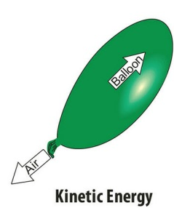
Research – Diagram(s)/Chart(s)
Potential Energy (PE)
Kinetic Energy (KE)
Notes:
Research Slide(s) Diagram(s) and/or Chart(s)
What is a diagram? A simplified drawing showing the appearance, structure, or workings of something; a schematic representation.
What is a chart? Information in the form of a table, graph, or diagram
You may need more than one slide depending on the number of diagrams and/or charts you find helpful to include in your research.
HINT: Justify the text to the left and use font size between 16 and 24 ☺ You may insert images of diagrams and/or charts.
Don’t forget to include project title, your name, teacher name and grade; at the bottom or side of the slide.

Slide 9
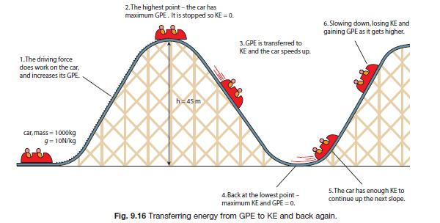
Research – Diagram(s)/Chart(s)
Gravitational potential energy (GPE) and kinetic energy (KE)
Image source: http://revisionworld.com/sites/revisionworld.com/files/imce/transferring%20energy.jpg
Notes:
Research Slide(s) Diagram(s) and/or Chart(s)
What is a diagram? A simplified drawing showing the appearance, structure, or workings of something; a schematic representation.
What is a chart? Information in the form of a table, graph, or diagram
You may need more than one slide depending on the number of diagrams and/or charts you find helpful to include in your research.
HINT: Justify the text to the left and use font size between 16 and 24 ☺ You may insert images of diagrams and/or charts.
Don’t forget to include project title, your name, teacher name and grade; at the bottom or side of the slide.

Slide 10
Bibliography
1
This source is a: book magazine newspaper website other:
Author’s Last Name First Name Middle Initial
Date Published | Title of Publication/Website Science Buddies
Title of Article Roller Coaster Marbles: How Much Height to Loop the Loop?
Place Published | Publisher | Editor
Edition | Volume Number | Page Number(s)
Website is a company organization government newspaper/magazine other
URL http://www.sciencebuddies.org/science-fair-projects/project_ideas/Phys_p036.shtml#summary |  | Last date of Access Nov 2015
X
X
2
This source is a: book magazine newspaper website other:
Author’s Last Name First Name Middle Initial
Date Published | Title of Publication/Website Mystery Science
Title of Article Why is the first hill of the roller coaster always the highest?
Place Published | Publisher | Editor
Edition | Volume Number | Page Number(s)
Website is a company organization government newspaper/magazine other
URL http://mysteryscience.com/energy/mystery-3/energy-collisions/34?r=625513 |  | Last date of Access Dec 2015
X
X
Notes:
Research Slide(s) Bibliography
What is a bibliography? A list of the written sources of information use to complete research on a subject.
You need to list 3 or more sources of information. Use the familiar box configuration and fill in the applicable spaces or type it as it is shown in Science Buddies.
You may need more than one slide depending on the number of sources you list and/or the format you use to list the sources.
HINT: With adult help you can use a bibliography generator such as http://www.easybib.com/ then copy and paste the citation to the slide.
Don’t forget to include project title, your name, teacher name and grade; at the bottom or side of the slide.

Slide 11
Bibliography (continuation)
3
This source is a: book magazine newspaper website other: video
Author’s Last Name First Name Middle Initial
Date Published | Title of Publication/Website YouTube.com
Title of Article Physical Science for Children All About Motion and Balance
Place Published | Publisher | Editor
Edition | Volume Number | Page Number(s)
Website is a company organization government newspaper/magazine other
URL http://www.youtube.com/watch?v=Ol03h95iZd4&list=PLNRtCH97 epyeKJFB1X4Jg24V5Kz_Of67o&index=10 |  | Last date of Access Dec 2015
X
X
X
Notes:
Research Slide(s) Bibliography
… continuation

Slide 12
Variables
Independent What you change This is the CAUSE | Dependent What you observe happening The results (data) This is the EFFECT | Controlled What you keep the SAME This is everything else
I change the height of the track like this: 20 cm 40 cm 60 cm 80 cm | What I observe happening is if the marble can loop the loop | Same marble Same size loop Same starting point on the track Same amount of force (gravity)
Notes:
Variables Slide (optional – if included you can earn up to 5 additional points)
HINT: Justify the text to the left using bullets and use font size between 16 and 24 ☺.
Don’t forget to include project title, your name, teacher name and grade; at the bottom or side of the slide.

Slide 13
Hypothesis
If the height of the track is 80 centimeters then the marble will loop the loop because according to my research the greater the height (potential energy) the faster the marble will move
(kinetic energy).
Notes:
Hypothesis Slide
HINT: Center the text and use font size between 16 - 24 and line spacing between 1.5 – 2.5 ☺.
Don’t forget to include project title, your name, teacher name and grade; at the bottom or side of the slide.

Slide 14
Materials
At least two 6 foot (183 cm) sections of 1-1/2 in (about 4 cm) diameter foam pipe insulation
2-3 glass marbles
Utility knife
Masking tape
Tape measure (metric)
Meter stick
Paper cup
Bookshelf, table, or other support for roller coaster starting point
Adult supervision
Notes:
Materials Slide
HINT: Justify text to the left using bullets and use font size between 16 - 24 and line spacing between 1 – 2 ☺.
You may include images of the materials.
Don’t forget to include project title, your name, teacher name and grade; at the bottom or side of the slide.

Slide 15
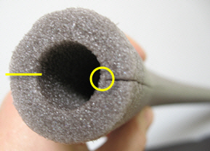
Procedure
Note: use the utility knife with care. A fresh, sharp blade will make cutting the insulation easier.
Do your background research so that you are knowledgeable
about the terms, concepts, and questions, above.
Cut the foam pipe insulation in half (the long way) to make two
U-shaped channels.
The illustration shows the foam pipe insulation, end-on.
The insulation comes with one partial cut along the entire
length. Complete this cut with the utility knife (yellow circle
in the illustration above).
Make a second cut on the other side of the tube (yellow line
in the illustration above), along the entire length of the tube.
You'll end up with two separate U-channel foam pieces. You
can use masking tape to attach pieces end-to-end to make
the roller coaster track as long as you want.
Pick a diameter for the loop. Something in the range of 30–50 cm (12–20 in) should work well.
Tape two lengths of the foam U-channel together, end-to-end. The joint between the two pieces
should be as smooth as possible.
Curl the track into a loop of the desired diameter. Tape the loop together where the two tracks meet
at the bottom (see illustration below). Don't tape the loop to the floor just yet.
Notes:
Procedure Slide(s)
You may need more than one slide depending on the number of steps your procedure has.
HINT: Justify text to the left using numbers and use font size between 12 - 18 and line spacing between 1.5 – 2 ☺.
You may include images of the steps from the procedure. If you followed the procedure exactly as it is in Science Buddies, then you can copy the procedure from the website and paste it on the slide and edit font size as needed.
Don’t forget to include project title, your name, teacher name and grade; at the bottom or side of the slide.

Slide 16
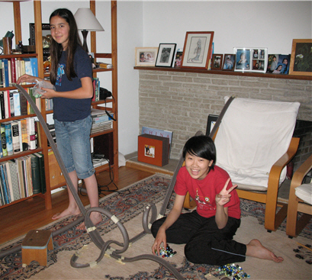
Procedure (continuation)
Raise the other end of the track up to make a ramp coming
down into the loop (see illustration below).
Tape the top of the ramp in place on a bookshelf or other
piece of furniture. The illustration shows two different roller
coaster tracks for marbles.
Now you can tape the loop down to the floor.
Measure the diameter of the loop.
Measure the height of the starting point for the track (rise).
Measure the horizontal distance from the track starting point to the beginning of the loop (run).
Run a single marble down the track 10 separate times. How many times does it successfully go through
the loop?
Change the height and repeat the previous step. If the marble makes it through
the loop most of the time, lower the height. If the marble fails to make it through
the loop most of the time, raise the height.
What starting height was needed for the marble to make it through the
loop most of the time?
Notes:
Procedure Slide(s)
You may need more than one slide depending on the number of steps your procedure has.

Slide 17
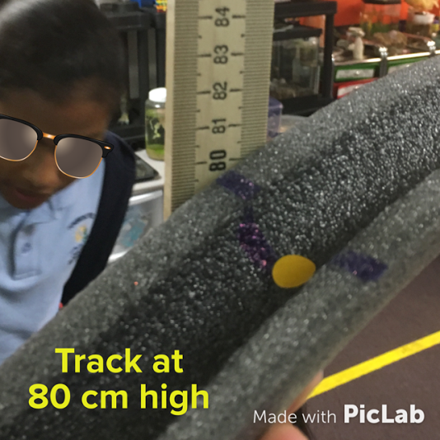
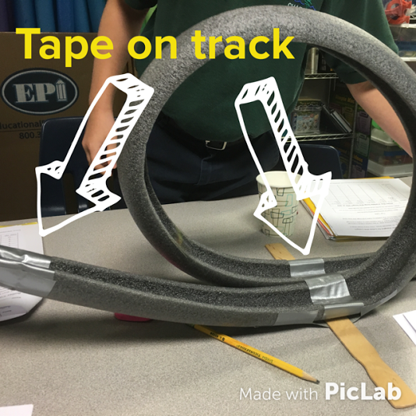
Data – Photographs
The yellow dot indicates the exact position from where to drop the marble for all different heights being tested.
The way the tape was placed on the track might have slowed down the marble during some of the trials, because sometimes the tape would come off a bit.
Notes:
Data Slide(s) – Photographs
You may need more than one slide depending on the number of photographs you took of the results (before, during, and after the experiment).
HINT: Don’t forget to include a detailed caption for each photograph (What is being tested? Which trial number? What happened? What’s the average? And anything other observations to make the photograph relevant as data)
Don’t forget to include project title, your name, teacher name and grade; at the bottom or side of the slide.

Slide 18
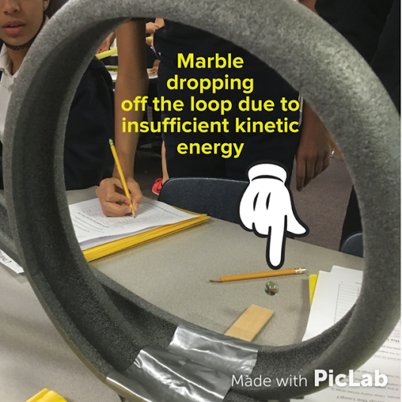
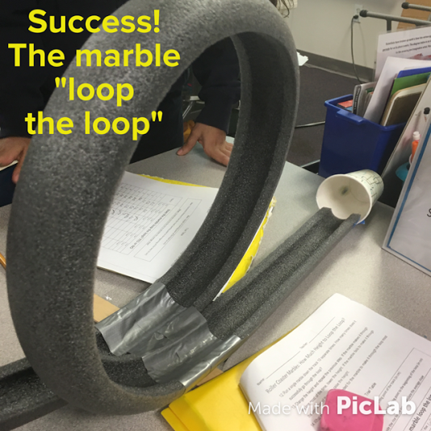
Data – Photographs
All of the trials for the 20 and 40 cm drop failed to convert the potential energy into enough kinetic energy for the marble to loop the loop.
The first time the marble completed the loop was at a height of 60 cm during trial 5.
Notes:
Data Slide(s) – Photographs
You may need more than one slide depending on the number of photographs you took of the results (before, during, and after the experiment).

Slide 19
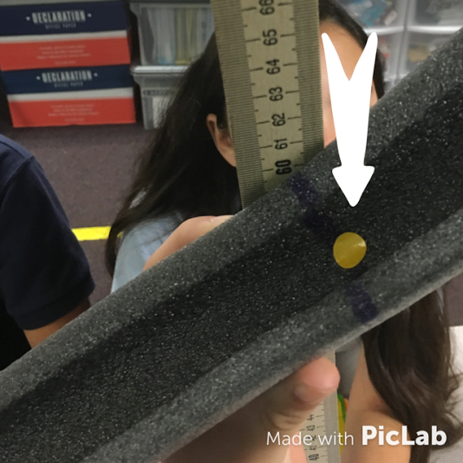
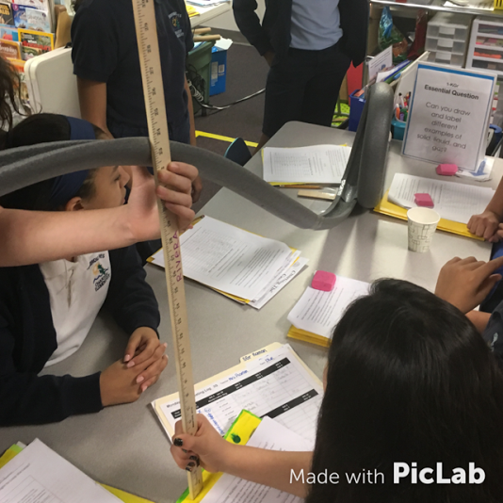
Data – Photographs
Ready to test 60 cm drop.
It’s very important to keep the meter stick next to the dot when measuring to change the height of the track.
Performing one of the ten trials for the 60 cm drop. Each change in height was tested ten times
Notes:
Data Slide(s) – Photographs
You may need more than one slide depending on the number of photographs you took of the results (before, during, and after the experiment).

Slide 20
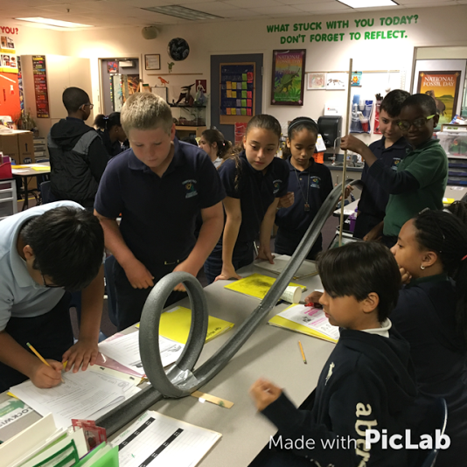
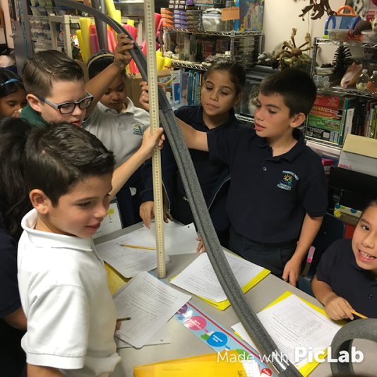
Data – Photographs
4 out of 10
at 60 cm
0 out of 10
at 40 cm
Performing one of the ten trials for the 40 cm drop. At this height the marble didn’t complete the loop.
Performing one of the ten trials for the 60 cm drop. At this height the marble completed the loop 4 out of 10 times.

Slide 21
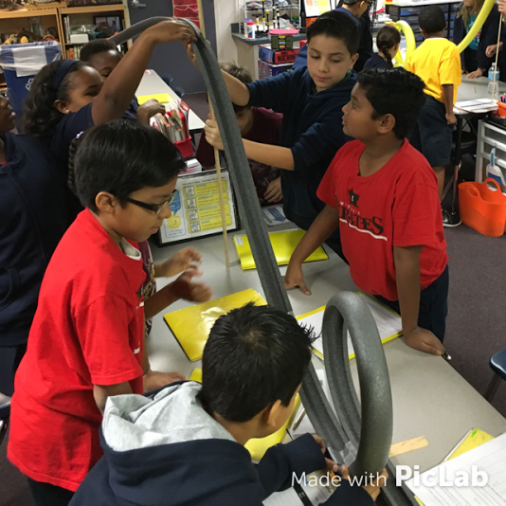
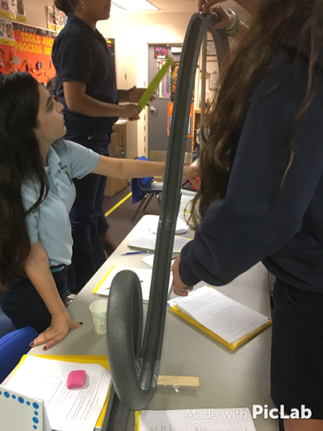
Data – Photographs
8 out of 10
at 80 cm
10 out of 10
at 100 cm
Performing one of the ten trials for the 80 cm drop. At this height the marble completed the loop 8 out of 10 times.
Performing one of the ten trials for the 100 cm drop. At this height the marble completed the loop 10 out of 10 times.
Notes:
Data Slide(s) – Photographs
You may need more than one slide depending on the number of photographs you took of the results (before, during, and after the experiment).

Slide 22
Data – Trial Table(s)
TRIALS | Does the marble loop the loop? YES or NO
 | Rise 20 cm | Rise 40 cm | Rise 60 cm | Rise 80 cm | Rise 100 cm | Rise 120 cm
 | Run | Run | Run | Run | Run | Run
 | Slope | Slope | Slope | Slope | Slope | Slope
1 | no | no | no | yes | yes | no
2 | no | no | no | yes | yes | no
3 | no | no | no | yes | yes | yes
4 | no | no | no | no | yes | yes
5 | no | no | yes | yes | yes | no
6 | no | no | no | no | yes | yes
7 | no | no | yes | yes | yes | yes
8 | no | no | yes | yes | yes | yes
9 | no | no | no | yes | yes | no
10 | no | no | yes | yes | yes | yes
Total YES | 0 | 0 | 4 | 8 | 10 | 6
Notes:
Data Slide(s) – Trial Table
You may need more than one slide depending on the number of data tables your project requires.
HINT: Use the insert function to design a table; if you are not familiar with this feature of MS Power Point there are other ways to do this ☺.
Use graph paper and design a table by hand then take a photo and insert it onto the slide
Use MS Excel then copy-paste, insert, or take a screen shot
Don’t forget to include project title, your name, teacher name and grade; at the bottom or side of the slide.

Slide 23
Data – Graph(s)
How Much Height to Loop the Loop?
Total Number of Times the Marble Loop the Loop
10
9
8
7
6
5
4
3
2
1
0
20 cm
40 cm
60 cm
80 cm
100 cm
120 cm
Rise of track
Notes:
Data Slide(s) – Graph
You may need more than one slide depending on the number of graphs your project requires. Remember that if your data is qualitative most likely you won’t be able to display it in a graph; if this is the case, you are exempt from making a graph
HINT: Use the insert function to design a graph; if you are not familiar with this feature of MS Power Point there are other ways to do this ☺.
Use graph paper and design a graph by hand then take a photo and insert it onto the slide
Use MS Excel then copy-paste, insert, or take a screen shot (watch this video to learn how to make a bar graph in excel https://www.youtube.com/watch?v=vV6WreL9wxo&list=PLNRtCH97epyfwxZkqhFvcP83r7kgvaqOv&index=48
Don’t forget to include project title, your name, teacher name and grade; at the bottom or side of the slide.

Slide 24
Conclusion
I hypothesized that if the height of the track is 80 centimeters then the marble will loop the loop because according to my research the greater the height (potential energy) the faster the marble will move (kinetic energy). The data from my experiment supports my hypothesis.
The data that supports my hypothesis shows that when the marble is dropped from 80 centimeters high its potential energy transforms into enough kinetic energy to allow the marble to loop the loop 8 out of 10 trials. The results were better when the marble was dropped from 100 centimeters because the marble loop to loop for all 10 trials. I think
Notes:
Conclusion Slide(s)
You may need more than one slide depending on the number of sentences you require to write a good conclusion.
HINT: Justify the text to the left and use font size between 16 - 24 and line spacing between 1.5 – 2.5 ☺
Don’t forget to include project title, your name, teacher name and grade; at the bottom or side of the slide.

Slide 25
Conclusion (continuation)
the way I applied the tape on the track might have slowed down the marble during some of the trials, because sometimes the tape would come off a bit. Throughout the trials I had to keep pressing the tape down to keep the track smooth.
In conclusion, according to the data the best height for a marble roller coaster with a 30 cm diameter loop is 100 cm. A possibility for further experimentation would be to change the diameter of the loop (30, 35, 40, 45, 50 cm) and test how large a loop can the marble complete when dropped from 100 cm high.
Notes:
Conclusion Slide(s)
You may need more than one slide depending on the number of sentences you require to write a good conclusion.

Slide 26
Application
How can you apply what you have learned to a real life situation?
I can apply what I learned about forces and motion, gravity, friction, and potential and kinetic energy to the Paper Roller Coaster Challenge. My deeper understanding of these science concepts will help me make an exciting paper roller coaster that meets the criteria of increasing the time the marble takes to travel from top to bottom.
Who would benefit from the information in your project, and why?
The 4th and 5th grade students in my school will benefit from the information in my project because they need to build loops for their paper roller coaster challenge. They can design a test for their paper loop to find out how much of a drop the marble will need to loop the loop. Figuring out the least amount of energy needed helps increase the time the marble will take to reach the finish line, therefore scoring more points.
Notes:
Application Slide
HINT: Justify the text to the left and use font size between 16 - 24 and line spacing between 1.5 – 2.5 ☺
You may insert images that show examples of applications for your project.
Don’t forget to include project title, your name, teacher name and grade; at the bottom or side of the slide.

Slide 27
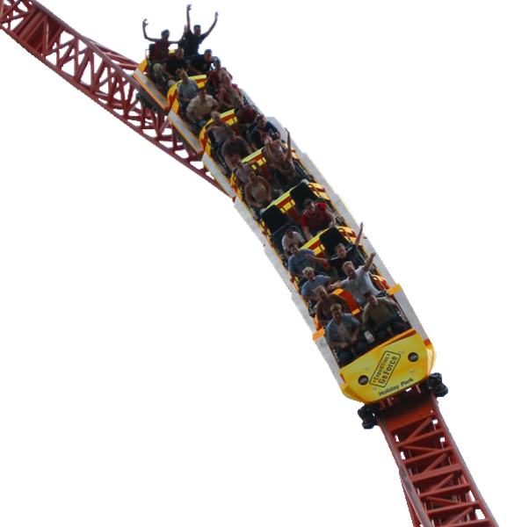
Potential energy
R O C K S
Kinetic energy
is awesome!!!
Notes:
End Slide (optional)
Have some fun creating an interesting ending to your slide show.
HINT: For the end slide you may insert an image and choose the font size ☺
Don’t forget to include project title, your name, teacher name and grade; at the bottom or side of the slide.

